Slide 1
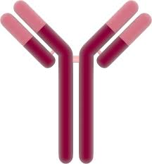
Two new parameters for characterizing ligand binding systems.
+
Andrew Stein
October 17, 2017
ACoP8 – Mathematical Pharmacology

Slide 2
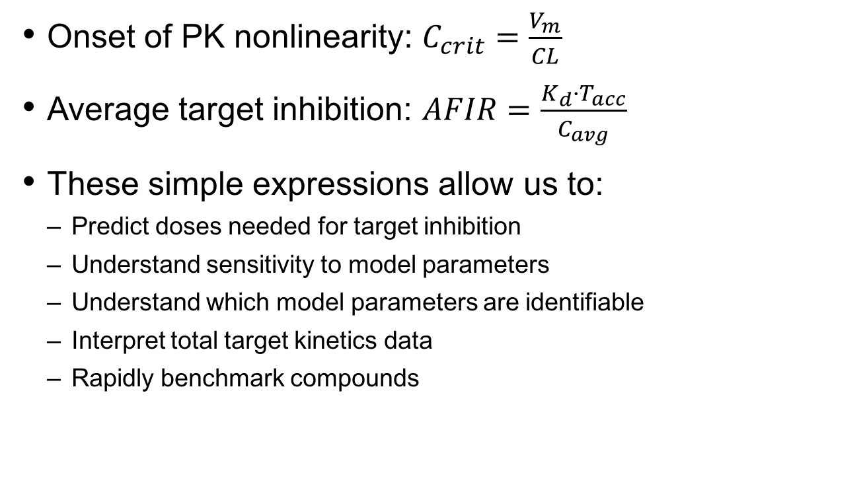
Overview
Onset of PK nonlinearity: $C_{crit}=\frac{V_{m}}{CL}$
Average target inhibition: $AFIR=\frac{K_{d}·T_{acc}}{C_{avg}}$
These simple expressions allow us to:
Predict doses needed for target inhibition
Understand sensitivity to model parameters
Understand which model parameters are identifiable
Interpret total target kinetics data
Rapidly benchmark compounds

Slide 3
Differences between small molecules and monoclonal antibodies
Property | Small Molecules | Monoclonal Antibodies (IgG1)
Molecular Weight | 500 Da | 150,000 Da
Half-Life (human) | minutes - hours | 3 weeks
Affinity for target | Moderate to high | Very high

Slide 4
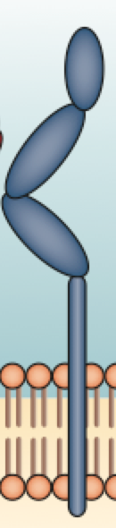
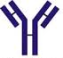
Soluble vs Membrane-Bound Targets
Drug (D)
Target (T)
Complex (DT)
Soluble
Target
Total Target (T+DT)
Accumulation
+
t1/2 ≈ 21 days
t1/2 ≈ 1h
t1/2 ≈ 21 days
+
Membrane-bound
Target
Nonlinear PK
t1/2 ≈ 21 days
t1/2 ≈ 1 hour
t1/2 ≈ 1 hour
AS

Slide 5
Characterizing onset of PK nonlinearity for membrane-bound targets
In collaboration with Bert Peletier at Leiden University in The Netherlands
Manuscript in progress. Contact andrew.stein@novartis.com if interested in further details.
+
t1/2 ≈ 21 days
t1/2 ≈ 1 hour
t1/2 ≈ 1 hour

Slide 6
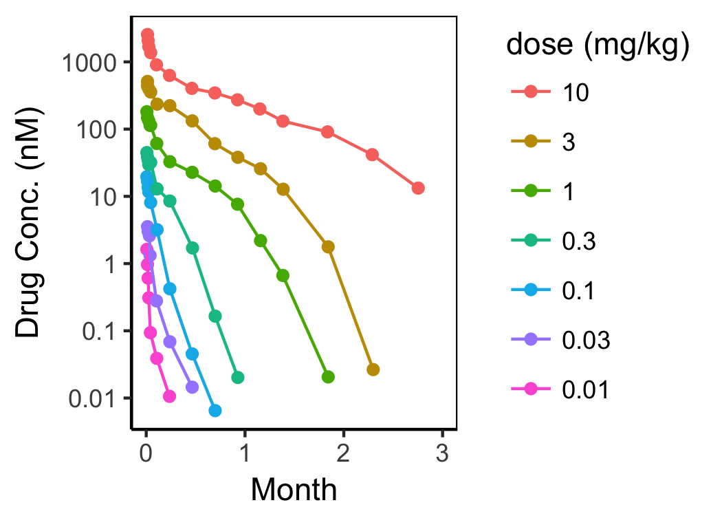
Nonlinear pharmacokinetics occurs at “critical concentration” = C_{crit}
Ccrit
Choose dose so conc. stays above Ccrit
Maintain target engagement
Reduce PK variability
Burmester, G. R. et al. Mavrilimumab, a human monoclonal antibody targeting gm-csf receptor-α, in subjects with rheumatoid arthritis: a randomised, double-blind, placebo- controlled, phase I first-in-human study. Annals of the rheumatic diseases 70, 1542–1549 (2011).

Slide 7
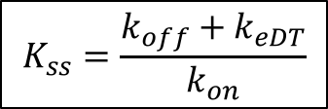
Michaelis-Menten approximation of ligand binding model
Ligand Binding Model
(Membrane-Bound)
Michaelis-Menten
Model
Dose
k_{syn}
Dose
C
+
T
K_{ss}
CT
C
CL/V_{c}
k_{eT}
k_{eCT}
≈
CL/V_{c} + V_{m}/(C+K_{m})
k₁₂
k₂₁
k₁₂
k₂₁
C_{P}
C_{P}
$$K_{ss}=\frac{k_{off}+k_{eDT}}{k_{on}}$$
V_{m} = k_{syn}·V_{c}
K_{m} = K_{ss}
Approximation derived in: Ma, Peiming. "Theoretical considerations of target-mediated drug disposition models: simplifications and approximations." Pharmaceutical research 29.3 (2012): 866-882.

Slide 8
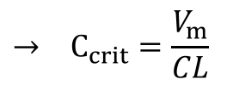
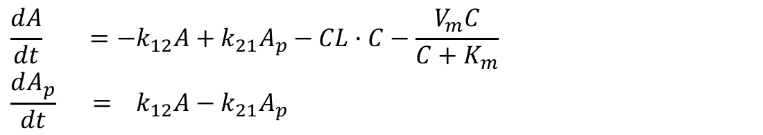
“Derivation” for C_{crit}
A = C·V_{c} A_{p} = C_{p}·V_{p}
$$\frac{dA}{dt} =−k_{12}A+k_{21}A_{p}−CL·C−\frac{V_{m}C}{C+K_{m}}$$
$$\frac{dA_{p}}{dt} ={ k}_{12}A−k_{21}A_{p}$$
A
+
A_{tot} =
A + A_{p}
CL/V_{c} + V_{m}/(C+K_{m})
k₁₂
k₂₁
$$\frac{dA_{tot}}{dt} =−CL·C−\frac{V_{m}C}{C+K_{m}};$$
A_{P}
For large doses (and concentrations), C ≫ K_{m}
$$\frac{dA_{tot}}{dt} ≈−CL·C−V_{m}$$
Define C_{crit} to be where the linear (CL·C) and nonlinear (V_{m}) components contribute equally to total elimination
$$→ C_{crit}=\frac{V_{m}}{CL}$$
$$CL·C_{crit}=V_{m}$$

Slide 9
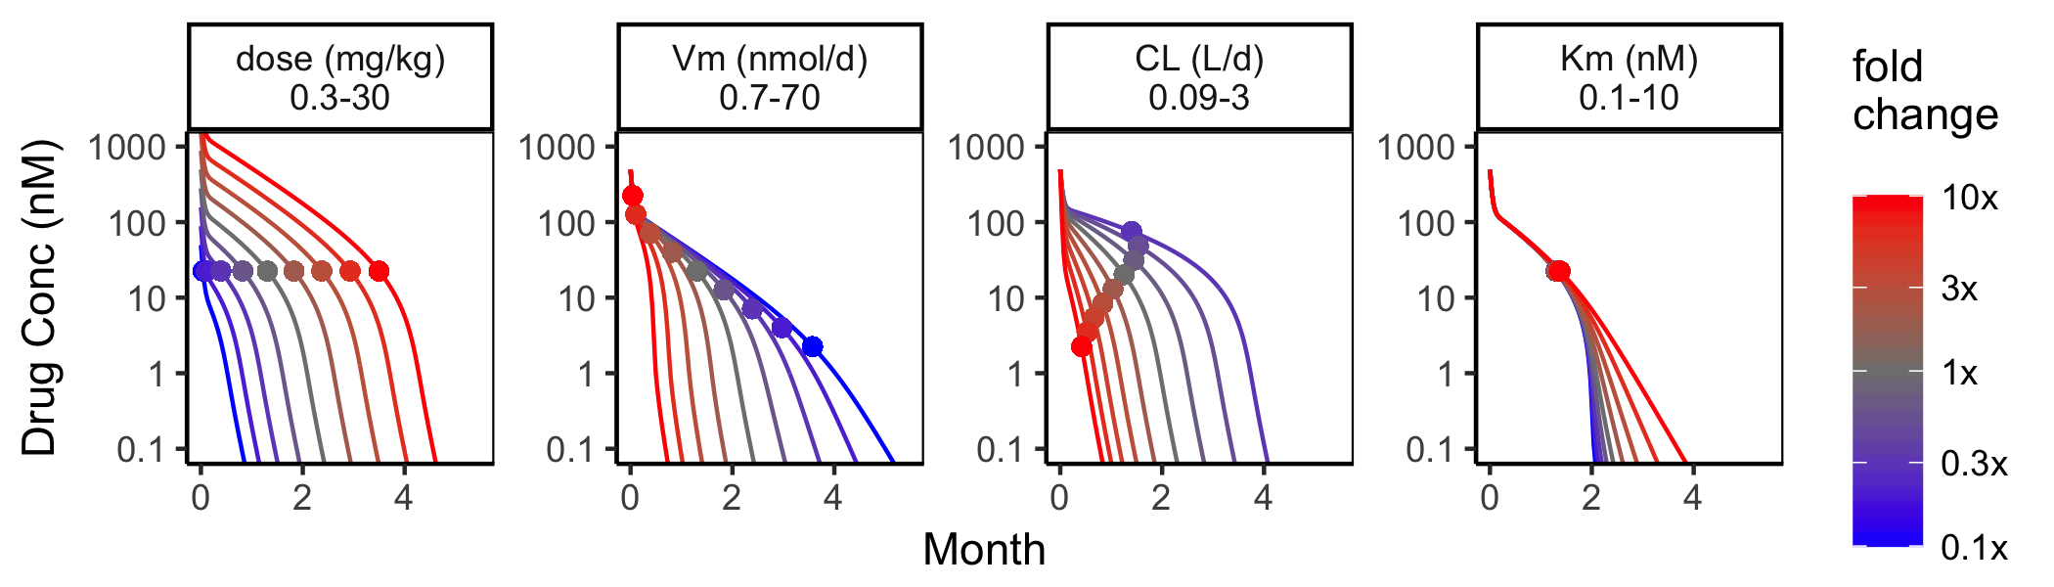
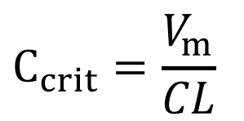
Sensitivity analysis for Ccrit
$$C_{crit}=\frac{V_{m}}{CL}$$

Slide 10
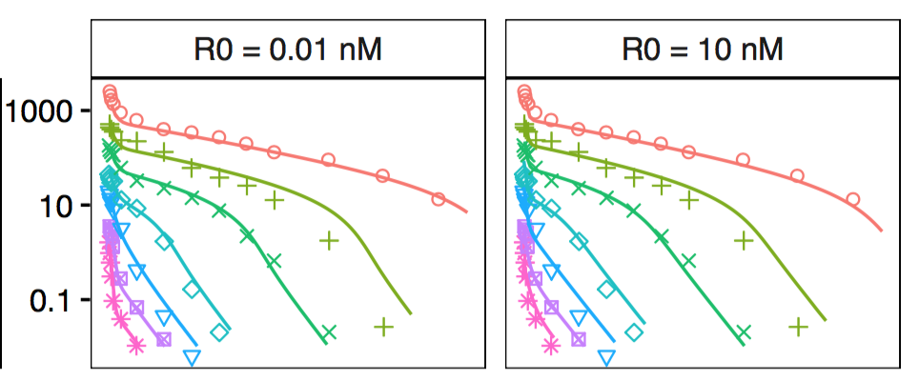
Ccrit helps in understanding parameter identifiability
Deriving initial parameter estimates: V_{m} = C_{crit}·CL_{from NCA}
Understanding which model parameters are identifiable
Vm = ksyn·Vc is often easiest “TMDD” parameter to estimate from nonlin. PK
Km (from steep elimination phase) can be more difficult to identify
R₀ (receptor density) is often impossible to estimate from PK alone [1]
Concentration (nM)
Month
Month
1. Stein, Andrew. "Practical unidentifiability of receptor density in target mediated drug disposition models can lead to over-interpretation of drug concentration data." bioRxiv (2017): 123240.

Slide 11
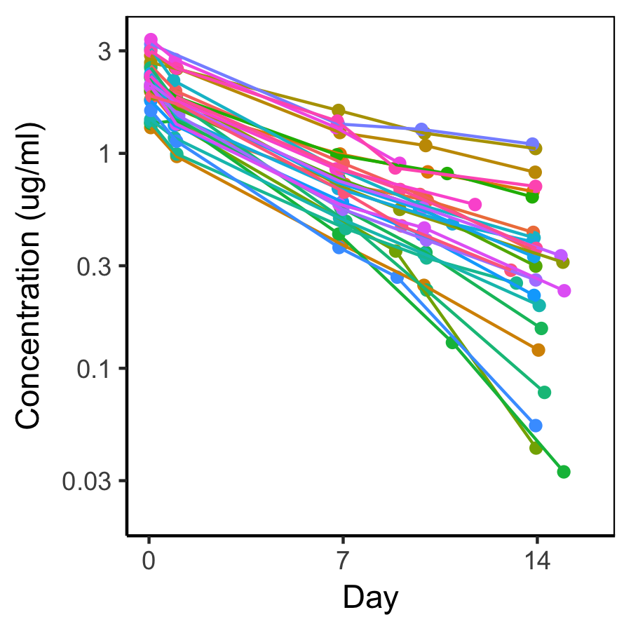
Random effect on Vm is important for describing variable Ccrit.
Some pts exhibited MM kinetics while others appear linear.
Ccrit varied between patients.
PopPK required random effect on Vm to characterize this heterogeneity

Slide 12
Characterizing soluble target inhibition
Stein, A. M., and Ramprasad Ramakrishna. "AFIR: A dimensionless potency metric for characterizing the activity of monoclonal antibodies." CPT: pharmacometrics & systems pharmacology 6.4 (2017): 258-266.
Additional work done at 2017 Math-to-Industry Bootcamp at the Institute of Mathematics and its Applications at University of Minnesota by Sameed Ahmed, Miandra Ellis, Ngartelbaye Guerngar, Hongshan Li, Luca Pallucchini
+
t1/2 ≈ 21 days
t1/2 ≈ 1h
t1/2 ≈ 21 days

Slide 13
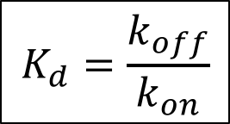
Ligand binding model (soluble target)
Total Target (Ttot) Assay
Measures both free and bound target
k_{syn}
Dose
C
T
K_{d}
CT
+
CL/V_{c}
k_{eT}
k_{eCT}
k₁₂
k₂₁
$$K_{d}=\frac{k_{off}}{k_{on}}$$
C_{P}

Slide 14
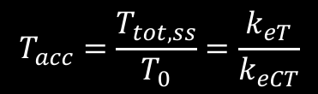
Sensitivity analysis. How does inhibition relate to parameters?
Total Target Conc.
(Ttot = T + CT)
subcutaneous
dosing
T_{tot,ss}
150 mg
28% free
$$T_{acc}=\frac{T_{tot,ss}}{T_{0}}=\frac{k_{eT}}{k_{eCT}}$$
300 mg
14% free
600 mg
7% free
T₀
Above 150 mg,
total target conc. plateaus
Above 150 mg, doubling dose halves the free target conc.

Slide 15
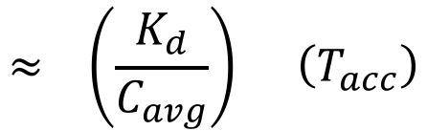
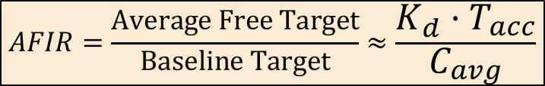
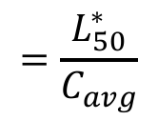
Estimating the free target compared to baseline
$$≈ \left(\frac{K_{d}}{C_{avg}}\right) \left(T_{acc}\right)$$
$$AFIR=\frac{Average Free Target}{Baseline Target}≈\frac{K_{d}·T_{acc}}{C_{avg}}$$
$$=\frac{L_{50}^{∗}}{C_{avg}}$$
Three key parameters that determine target inhibition
Kd: Binding affinity (Kd)
Tacc: Target accumulation at steady state
Cavg: Average drug concentration at steady state
Doubling dose or halving Kd reduces free target by 50%
* L₅₀ was recently derived in: Gabrielsson et al., Pharmacology & Therapeutics, https://doi.org/10.1016/j.pharmthera.2017.10.011

Slide 16
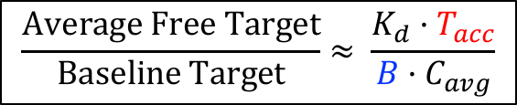
AFIR can also be applied to a target tissue (in progress)
Target
Tissue (3)
D₃
+
T₃
DT₃
Central (1)
D₁
+
T₁
DT₁
Dose
$$\frac{Average Free Target}{Baseline Target}≈ \frac{K_{d}·T_{acc}}{{B·C}_{avg}}$$
Peripheral (2)
D₂
B = tissue biodistribution coefficient,
≈ 30% is often assumed
Target accumulation (Tacc) in tissue is difficult to measure. Often assumed = 1

Slide 17
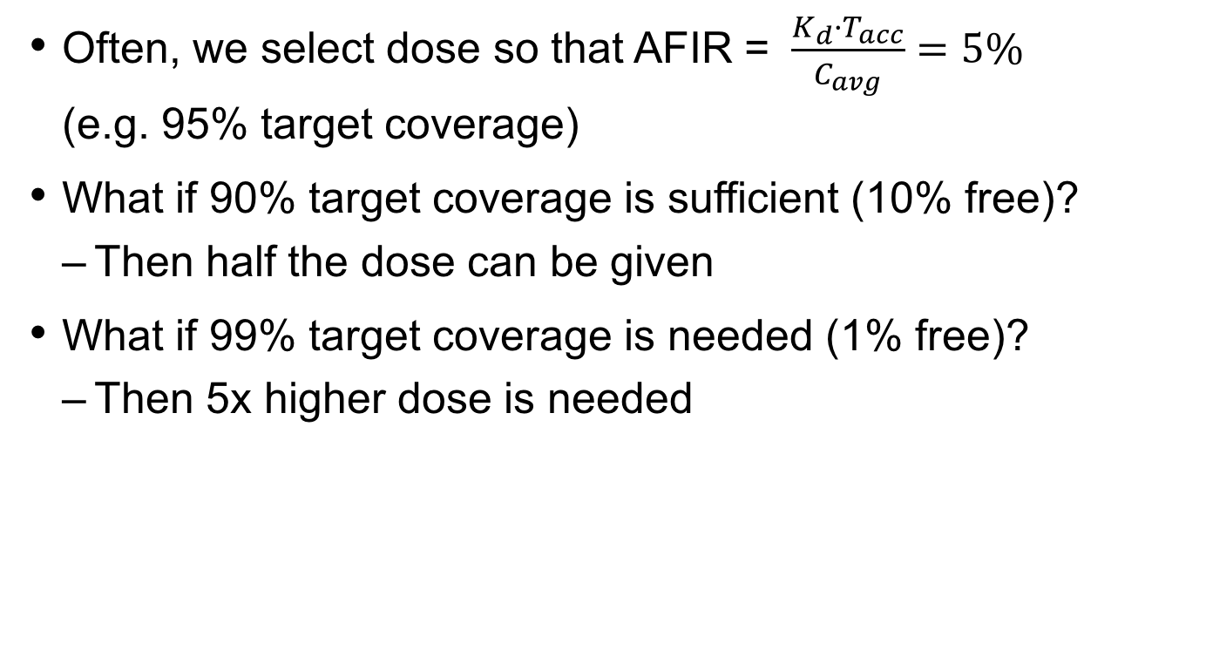
Using AFIR, sensitivity to assumptions is easy to report
Often, we select dose so that AFIR = $\frac{K_{d}·T_{acc}}{C_{avg}}=5\%$ (e.g. 95% target coverage)
What if 90% target coverage is sufficient (10% free)?
Then half the dose can be given
What if 99% target coverage is needed (1% free)?
Then 5x higher dose is needed

Slide 18
Development of oral drug with same target as subcutaneous biologic
Challenges
Oral biologics denatured in stomach
Small molecules will have poorer affinity (Kd) and higher elimination (CL)
How will new drug compare to first generation drug?

Slide 19
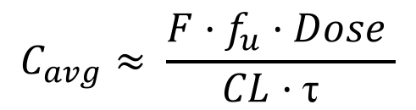
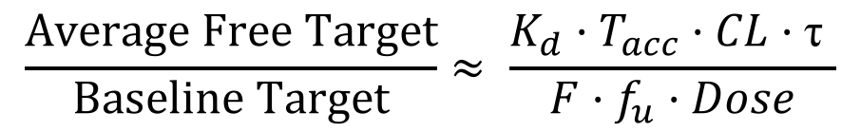
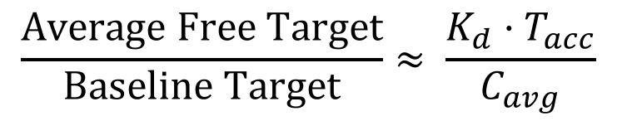
Applying AFIR to 2nd generation drugs
Kd | Binding Affinity
T_{acc} | Target Accumulation
C_{avg} | Avg. Free Drug Conc.
$$\frac{Average Free Target}{Baseline Target}≈ \frac{K_{d}·T_{acc}}{C_{avg}}$$
+
F | Bioavailability
fu | Fraction Unbound (small molecule)
CL | Clearance
τ | Dosing Interval
$$C_{avg}≈ \frac{F·f_{u}·Dose }{CL·\text{τ} }$$
$$\frac{Average Free Target}{Baseline Target}≈ \frac{K_{d}·T_{acc}·CL·\text{τ} }{F·f_{u}·Dose}$$

Slide 20
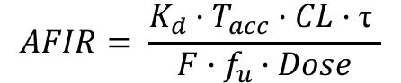
Using AFIR, other drug candidates can be rapidly assessed
 |  |  | subcutaneous mAb (150 kDa) | Oral biologic (50 kDa) | Oral, small molecule (500 Da)
Affinity | Kd | nM | 0.2 | 0.002 | 100
Accumulation | Tacc | - | 200 | 200 | 1
Clearance | CL | L/day | 0.17 | 1 | 100
Dose Interval | τ | day | 30 | 1 | 1
Bioavailability | F | - | 0.76 | **0.002** | 0.1
Free fraction | fu | - | 1 | 1 | 0.1
Dose at 300 mg | Dose | nmol | 2000 | 6000 | 600,000
AFIR |  | - | 14% | 14% | ≈100%
$$AFIR= \frac{K_{d}·T_{acc}·CL·\text{τ} }{F·f_{u}·Dose}$$

Slide 21
Greater efficacy is observed at 2x dose, even though total target has plateaued.
Total Target Data
Similar for X mg and 2X mg
Efficacy Metric
Superior for 2X dosing
2x dose
Conc. (nM)
T_{acc} = 200x
x dose
Week
Week
AFIR goes from 28% to 14% after doubling dose.
It is the 200x accumulation of target (T_{acc}) that necessitates high doses

Slide 22
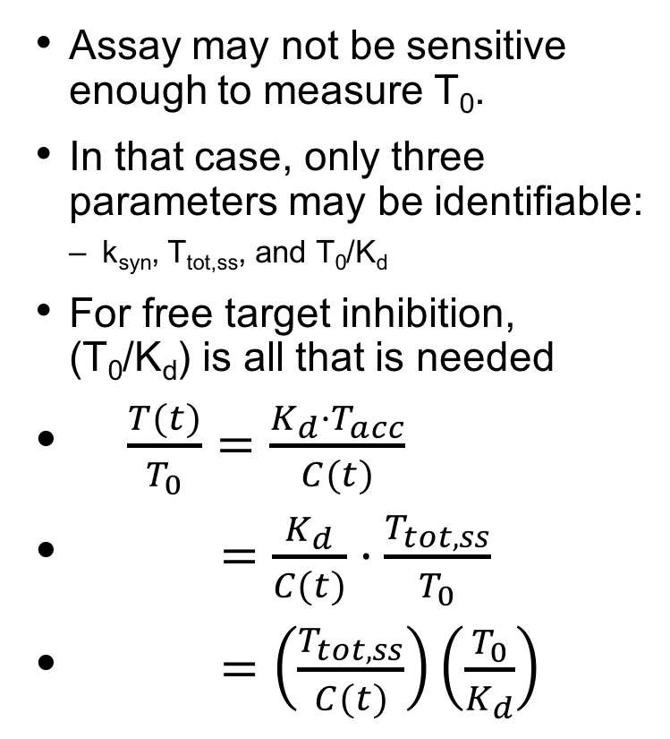
Identifiability –target inhibition can be estimated without baseline levels
Assay may not be sensitive enough to measure T₀.
In that case, only three parameters may be identifiable:
k_{syn}, T_{tot,ss}, and T₀/K_{d}
For free target inhibition, (T₀/K_{d}) is all that is needed
$\frac{T(t)}{T_{0}}=\frac{K_{d}·T_{acc}}{C(t)}$
$=\frac{K_{d}}{C(t)}·\frac{T_{tot,ss}}{T_{0}}$
$=\left(\frac{T_{tot,ss}}{C(t)}\right)\left(\frac{T_{0}}{K_{d}}\right)$
Varying T0,
keeping T0/Kd fixed
LOQ
Same % inhibition
for different baseline T0
See poster T-087 for application to 4 compounds

Slide 23
Two new parameters for characterizing ligand binding systems
Onset of PK nonlinearity: $C_{crit}=\frac{V_{m}}{CL}$
Average target inhibition: $AFIR=\frac{K_{d}·T_{acc}}{C_{avg}}$
These simple expressions allow us to:
Predict doses needed for target inhibition
Understand sensitivity to model parameters
Understand which model parameters are identifiable
Interpret total target kinetics data
Rapidly benchmark compounds

Slide 24
Acknowledgements
Mick Looby
Bert Peletier
Prasad Ramakrishna
Henning Schmidt
Jean-Louis Steimer
Phil Lowe
Karthik Subramanian
Bruce Gomes
Wenping Wang
Kostas Biliouris
Alison Margolskee
Jaeyeon Kim
Siyan Xu
Brian Stoll
Gerard Bruin
Irina Koroleva
Frank Kolbinger
Max Woisetschlaeger

Slide 25
Backups

Slide 26
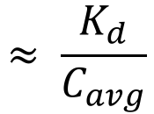
Calculating Free Target vs Total Target
1) Free Target
vs Total Target
Algebraic manipulation of quasi-equilibrium equation
$$≈ \frac{K_{d}}{C_{avg}}$$
When Dtot >> Ttot, Kd

Slide 27
The Quasi-Equilibrium Assumption
Assumption: binding is rapid such that drug, target, and complex stay in equilibrium.
This assumption allows us to reduce number of state variables from four [D, T, DT, D_{P}] to three [D_{tot}, T_{tot}, D_{P}] plus an algebraic set of equations

Slide 28
Analysis of total target dynamics before dosing
Before Dose, DT=0
At steady state: dT_{tot}/dt = 0

Slide 29
Analysis of total target dynamics after dosing
2) Total Target
accumulation
For large drug conc.,
most target is bound,
T ≈ 0, and DT ≈ T_{tot}
T_{tot}
At steady state: dT_{tot}/dt = 0
T_{acc}

Slide 30
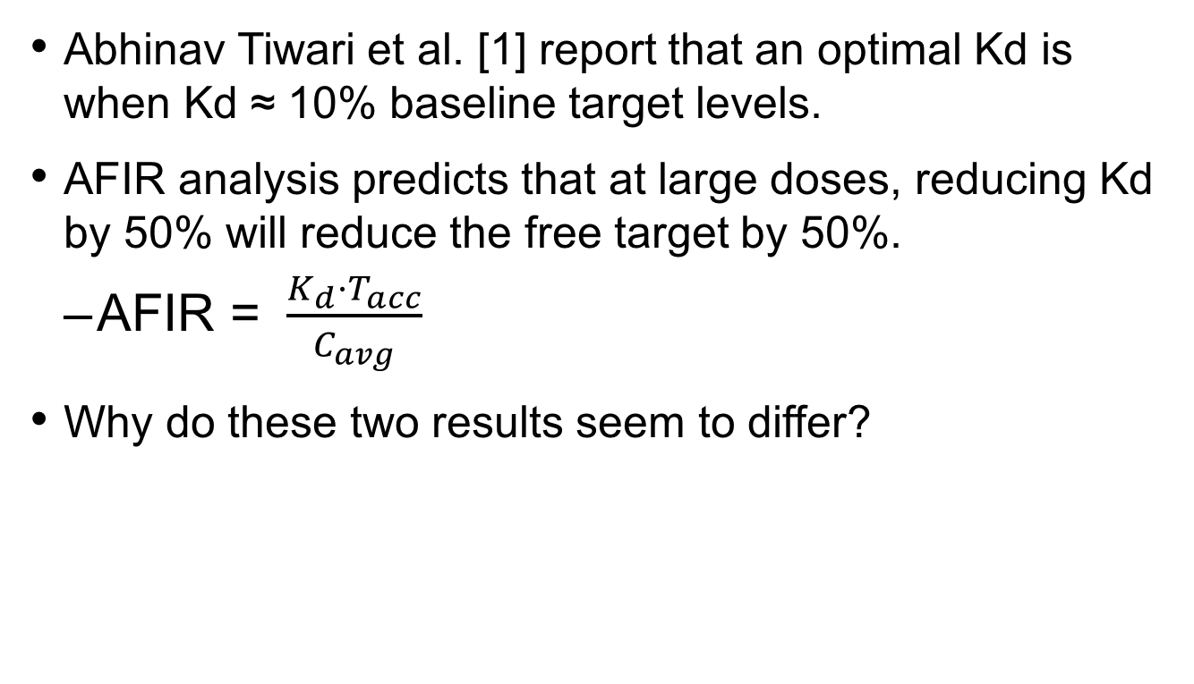
Is there an optimal Kd? It depends on definition of “optimal”
Abhinav Tiwari et al. [1] report that an optimal Kd is when Kd ≈ 10% baseline target levels.
AFIR analysis predicts that at large doses, reducing Kd by 50% will reduce the free target by 50%.
AFIR = $\frac{K_{d}·T_{acc}}{C_{avg}}$
Why do these two results seem to differ?
1. Tiwari, Abhinav, et al. "Optimal Affinity of a Monoclonal Antibody: Guiding Principles Using Mechanistic Modeling." The AAPS journal 19.2 (2017): 510-519.

Slide 31
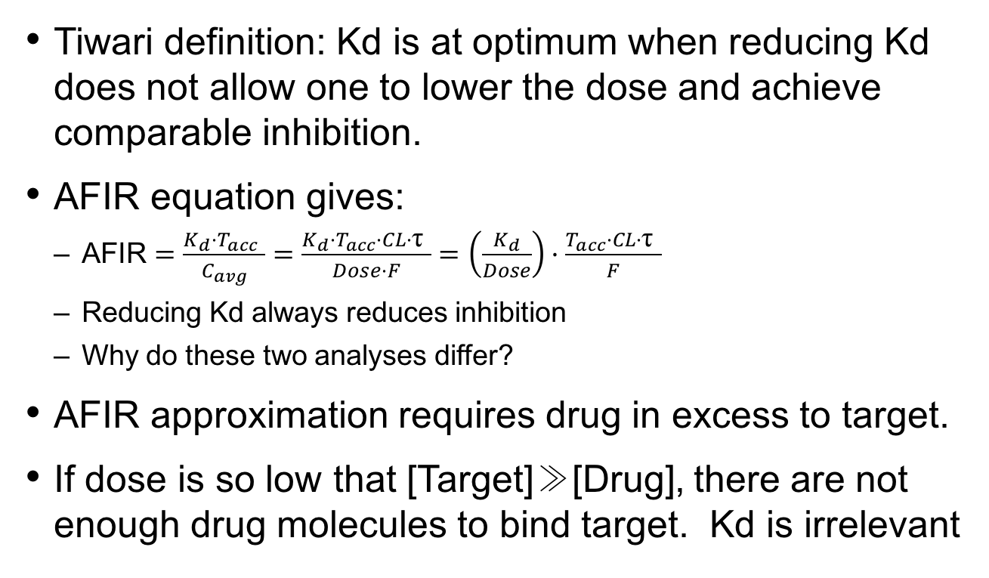
Tiwari defines “optimal” Kd with respect to dose reduction
Tiwari definition: Kd is at optimum when reducing Kd does not allow one to lower the dose and achieve comparable inhibition.
AFIR equation gives:
AFIR $=\frac{K_{d}·T_{acc} }{C_{avg}}=\frac{K_{d}·T_{acc}·CL·\text{τ} }{Dose·F}=\left(\frac{K_{d}}{Dose}\right)·\frac{T_{acc}·CL·\text{τ} }{F}$
Reducing Kd always reduces inhibition
Why do these two analyses differ?
AFIR approximation requires drug in excess to target.
If dose is so low that [Target]≫[Drug], there are not enough drug molecules to bind target. Kd is irrelevant

Slide 32
Questions for TMDD models
What % of drug gets into the tumor (B)?
Can soluble targets accumulate in tumor? Or other tissue?
Future research
Account for both membrane-bound and soluble ligands + shedding
Account for competitive endogenous ligand
Account for spatial heterogeneity in the tumor

